Slide 1
Energy Efficient SDN Commodity Switch based
Practical Flow Forwarding Method
Author: Amer AlGhadhban and Basem Shihada
Publisher: 2016 IEEE/IFIP Network Operations and Management Symposium
Presenter: Yi-Tsung Huang
Date: 2017/02/08
Department of Computer Science and Information Engineering
National Cheng Kung University, Taiwan R.O.C.
Notes:
1

Slide 2
Introduction
SDN-based solutions which use the OpenFlow protocol as the underlying paradigm suffer from several unexpected challenges, such as thousands of flow-entries, controller messages and unacceptable flow-setup delay.
In our solution, defined as EncPath, we exploit the ability of a controller to get complete information of a network path before installing the flow.
Notes:
78 K flow entyies

Slide 3
Introduction
The work herein is designed to reduce the energy consumptions of data-plane devices by reducing flow entries in flow table.
This achieved by encoding the flow path information into the packet IP or MAC addresses while the address rewriting flow entries are offloaded to be handled by hosts themselves.

Slide 4
The Overhead of Flow Entries
We build a simple experiment to measure the number of flow-entries needed by proactive-based solutions.
We build our investigation on an OpenFlow executed on Openvswitch 1.10 in mininet which is installed on top of Intel Xeon CPU X5550 2.67GHz 16 cores with 48GB memory and the latest version of POX controller.

Slide 5
The Overhead of Flow Entries
We measured the number of flow entries needed by ECMP to enable a single edge switch to directly handles the network flows without involving the controller.
Notes:
ECMP: Equal Cost MultiPath

Slide 6
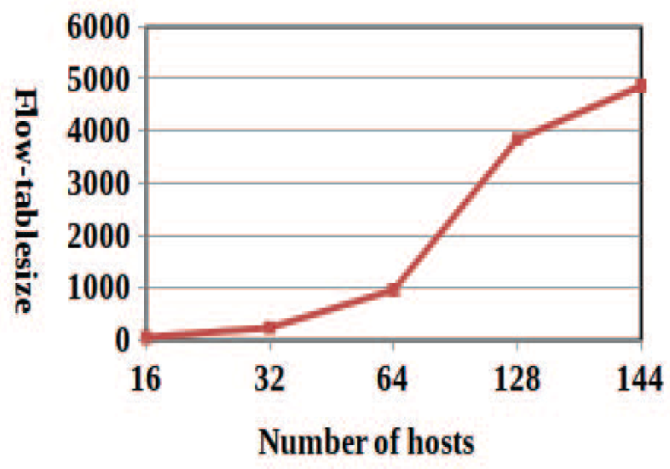
The Overhead of Flow Entries

Slide 7
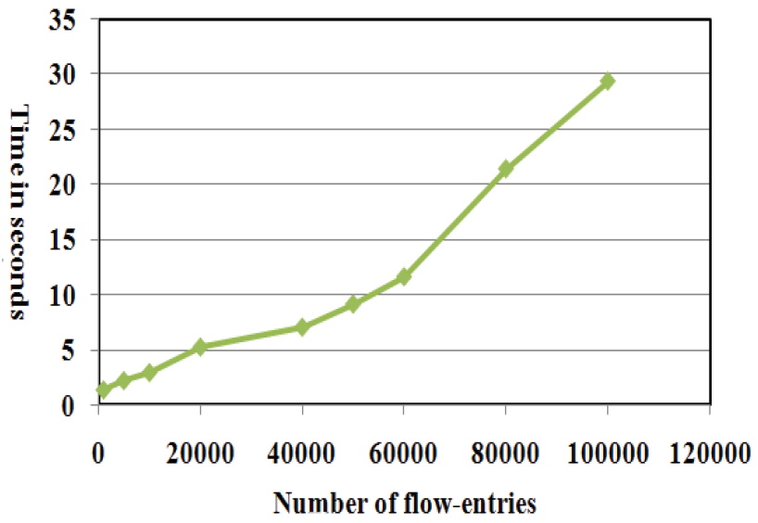
The Overhead of Flow Entries
We measured the effect of different sizes of flow-tables on the flow status request delay.

Slide 8
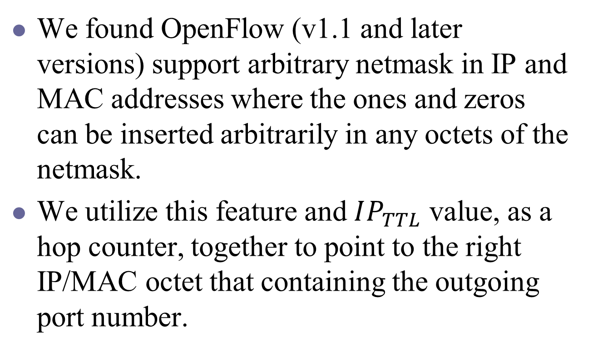
EncPath Design
We found OpenFlow (v1.1 and later versions) support arbitrary netmask in IP and MAC addresses where the ones and zeros can be inserted arbitrarily in any octets of the netmask.
We utilize this feature and $IP_{TTL}$ value, as a hop counter, together to point to the right IP/MAC octet that containing the outgoing port number.

Slide 9
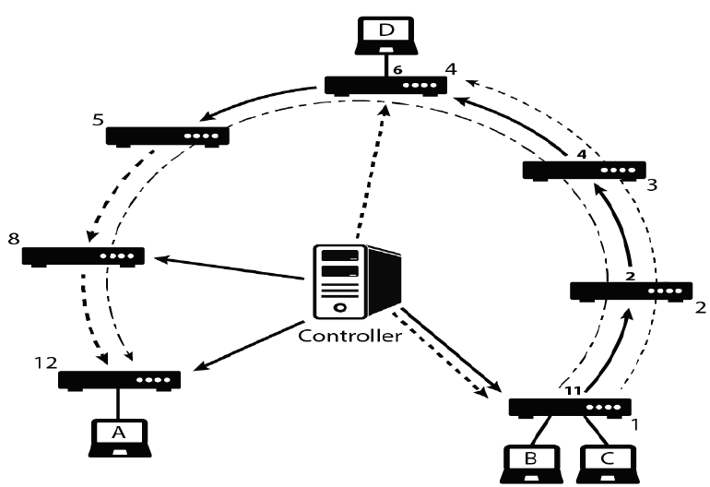
EncPath Design

Slide 10
EncPath Design
Host B aims to send a message to Host D.
SW1 rewrites the source IP address of the packet into srcIP = 11.2.4.6 and in this example destination IP will not be changed.
SW4 will rewrite the source IP address of the packet back to its original value.

Slide 11
EncPath Design
In EncPath, the controller installs in each in-path switch proactive flow entries consist of the outgoing port number in the IP octet which represents the switch location in the path.

Slide 12
EncPath Power Model
Since, TCAM has a limited capacity, where it can not accommodate the expected flow entries of data center network devices.
We measure the energy efficiency of our solution and others based on the energy consumption of DRAM.

Slide 13
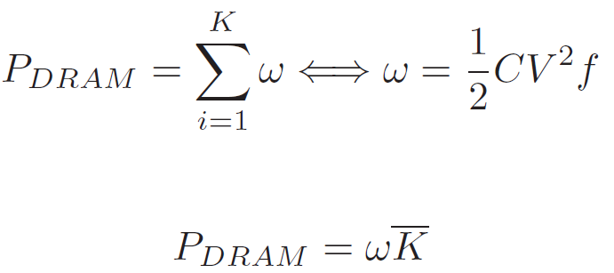
EncPath Power Model
Notes:
C: capacitance
V: voltage
F: clock speed
K: flow entry

Slide 14
Offload Flow-Setup
We build a direct OpenFlow southbound communication between the servers and the controller.
In this configuration the flow setup load on the edge switches are offloaded and spread among servers in the same subnet.

Slide 15
Path Length Challenge
When the path is longer than 8/12 hops, at the same time the controller inserts the rewriting entries in the edge devices, it also, inserts a rewriting entry in the 8th/12th switch to again rewrites the packet address of that flow with the subsequent path information.

Slide 16
Path Length Challenge
We use the combination of source and destination MAC addresses, TTL value and EncPath information as a Flow-ID which is used by the 8th/12th switch to recognize the targeted flow.

Slide 17
Validation and Results
The propose solution is validated in two different scenarios to prove its robustness
  three-layer homogeneous fat-tree, k=4
  a linear topology with 12 switches and 4 hosts
We built a testbed containing of 7 virtual machines to represent a single pod of the fat-tree topology and use it as an example of real implementation of our solution.

Slide 18
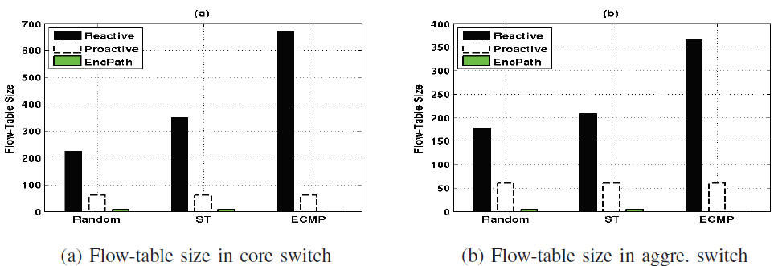
Three-layer Homogeneous Fat-Tree Results

Slide 19
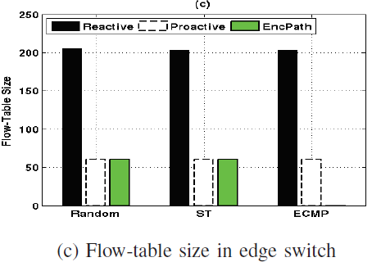
Three-layer Homogeneous Fat-Tree Results

Slide 20
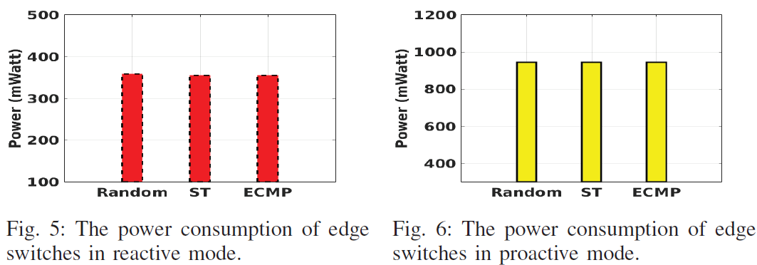
Three-layer Homogeneous Fat-Tree Results

Slide 21
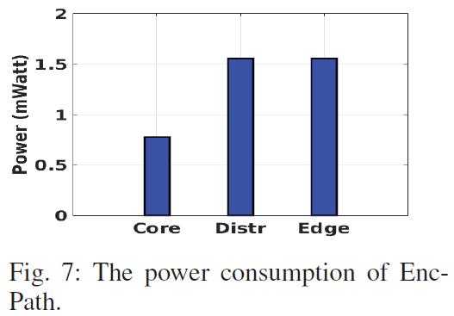
Three-layer Homogeneous Fat-Tree Results

Slide 22
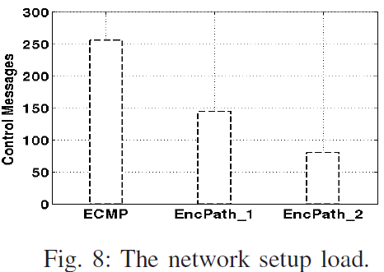
Three-layer Homogeneous Fat-Tree Results

Slide 23
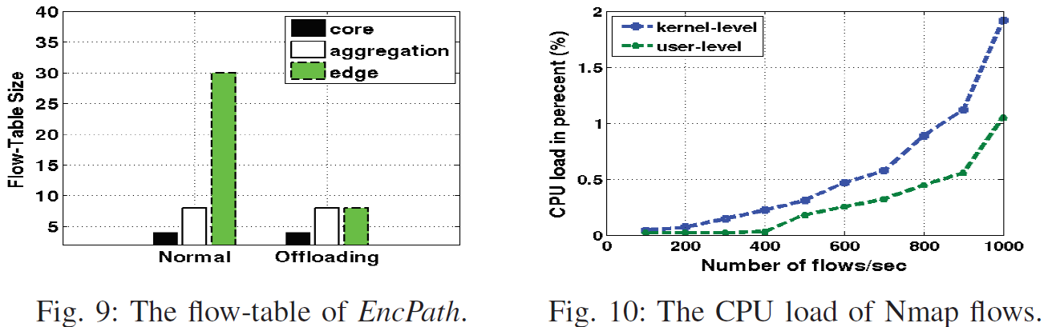
Edge Switches Flow offloading Results
Notes:
5 switch 2 server

